Slide 1



MARATHON ASSET MANAGEMENT
CORNELL CFEM CAPSTONE 2026
Marathon Project Meeting
Transitioning from Index Construction to Risk Detection
SPONSOR: Jason Foster
ADVISOR: Sasha Stoikov
TEAM: Alex Lee, Max Yap, Minxi Lin, Yung Lee, Olivia Mei
DATE: September 24, 2026

Slide 2
MARATHON ASSET MANAGEMENT
Future Project Direction
CORNELL CFEM CAPSTONE 2026
Index Construction (How does the overall private credit market look like?) → Risk Detection (How can we systematically detect impending credit/default risks beforehand?)
A List of Risk Signals To Be Used (BDC-level + Borrower-level):
Concentration – How much AUM is concentrated on a particular BDC? (BDC-level)
Crowding – How many BDCs and investment loans are involved in a particular borrower? (Borrower-level)
Valuation Dispersion – Is the FV/Cost ratio of a particular borrower diverging across BDCs? (Borrower-level)
PIK Trend – Is the non-cash portion of the investment loan increasing? (BDC-level + Borrower-level)
Sector – Which sector is most susceptible to credit/default risk? (BDC-level + Borrower-level)
Biggest Challenge for implementing the Systematic Approach: Extracting borrower name from investment_identifier
Question: What kind of system/metrics to report? Applying a ML technique like Random Forest?

Slide 3


MARATHON ASSET MANAGEMENT
Herfindahl-Hirschman Index (HHI)
CORNELL CFEM CAPSTONE 2026
A commonly-used measure to market or portfolio weight concentration
  Minimum value: 1/N (N: number of firms) – equal market shares among all N firms (perfect competition)
  Maximum value: 1 – only one firm takes all market shares (single monopoly)
n : number of BDCs per quarter
FV_i : aggregate fair values of investment loans per BDC, per quarter

Slide 4
AUM Concentration by Quarter
MARATHON ASSET MANAGEMENT
CORNELL CFEM CAPSTONE 2026
Quarter | Active BDCs | Total AUM ($B) | Top-5 (%) | Top-10 (%) | HHI | Eff. # BDCs (1/HHI)
2023Q1 | 94 | 232.6 | 44.9 | 58.9 | 0.0697 | 14.4
2023Q2 | 102 | 240.6 | 43.1 | 56.7 | 0.0644 | 15.5
2023Q3 | 117 | 245.2 | 42.7 | 53.3 | 0.0625 | 16.0
2023Q4 | 125 | 275.1 | 39.5 | 52.8 | 0.0558 | 17.9
2024Q1 | 129 | 298.0 | 37.7 | 50.9 | 0.0514 | 19.4
2024Q2 | 134 | 327.2 | 37.3 | 51.1 | 0.0499 | 20.0
2024Q3 | 138 | 358.3 | 37.1 | 50.5 | 0.0494 | 20.2
2024Q4 | 140 | 387.2 | 37.2 | 50.9 | 0.0511 | 19.6
2025Q1 | 145 | 416.9 | 36.9 | 51.8 | 0.0488 | 20.5
2025Q2 | 158 | 447.4 | 36.9 | 51.2 | 0.0476 | 21.0
2025Q3 | 161 | 476.1 | 37.1 | 51.5 | 0.0469 | 21.3
2025Q4 | 165 | 507.1 | 36.9 | 51.7 | 0.0468 | 21.3
2026Q1 | 167 | 488.0 | 36.7 | 49.7 | 0.0467 | 21.4
2026Q2 | 167 | 508.0 | 35.4 | 50.1 | 0.0429 | 23.3

Slide 5
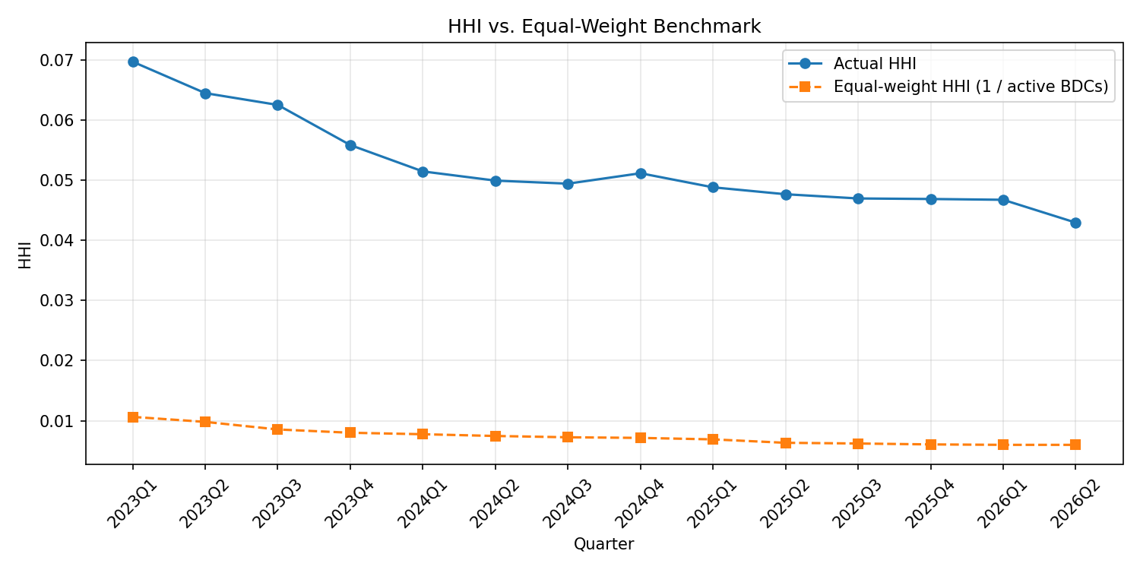
MARATHON ASSET MANAGEMENT
HHI vs. Equal-Weight Benchmark
CORNELL CFEM CAPSTONE 2026

Slide 6
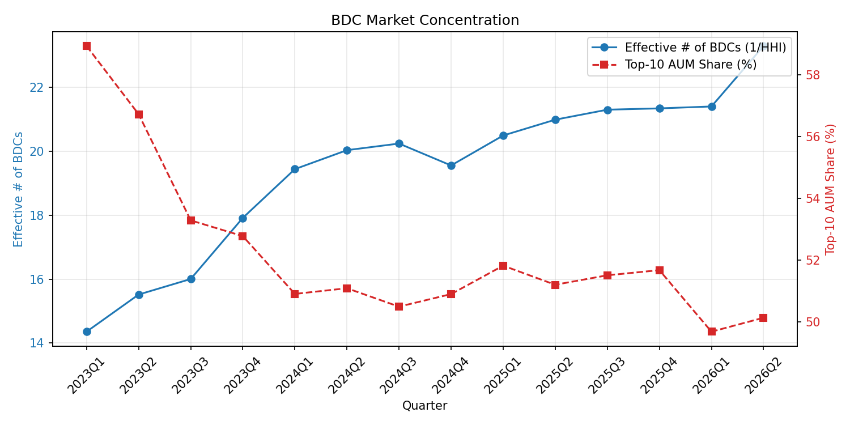
MARATHON ASSET MANAGEMENT
BDC Market Concentration
CORNELL CFEM CAPSTONE 2026

Slide 7
MARATHON ASSET MANAGEMENT
Challenge to Systematically Detecting Crowding
CORNELL CFEM CAPSTONE 2026
Main Issue: Highly inconsistent investment_identifier by different BDCs + no index/identifier for borrowers, unlike BDCs (CIK)
→ Difficult to identify the number of investment loans and the number of BDCs involved for each borrower
Examples:
Wildly different template wrapped around the same borrower, same quarter
First Brands Group, LLC (2025Q2) – 15 BDCs, 24 investment loans
“First Brands Group, LLC, Senior Secured Loans”
“First Brands, Inc. Industry Transportation Equipment Manufacturing Security 1st Lien, Secured Loan…”
“Senior Secured Loans-First Lien, First Brands Group”
“Debt Investments First Lien Senior Secured First Brands Group, LLC Industry Auto Components…”
A filer changing its own template between quarters
Hyland Software, Inc., same CIK (1655887), 2025Q3-2025Q4
“Hyland Software, Inc., First lien senior secured loan” (2025Q3) → “Hyland Software, Inc. | First lien senior secured loan | Non-affiliated”
Punctuation/encoding variants of one name
Claire’s Stores, Inc. – four different renderings across filers and time:
“Claire’s Stores, Inc.” (straight apostrophe)
“Claires Stores, Inc.” (dropped apostrophe)
“Claire&rsquo;s Stores, Inc.” (unescaped HTML entity remaining in the raw text)

Slide 8
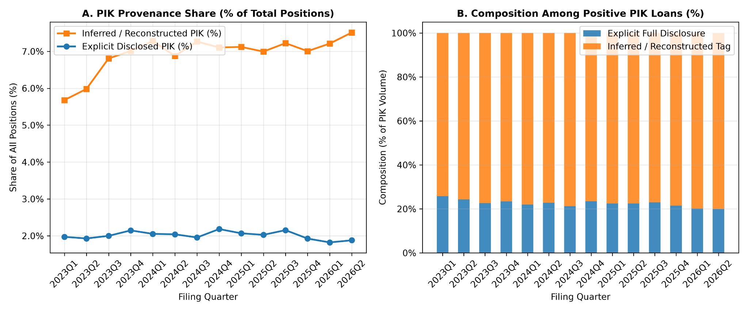
MARATHON ASSET MANAGEMENT
BDC PIK Trends
CORNELL CFEM CAPSTONE 2026
Main Question: Can we use the increasing non-cash portion of the loan as a signal for BDC distress?
What proportion of the PIK data is derived from explicit SEC iXBRL tags and what proportion is imputed?
Imputed via row has a null raw PIK tag, but compute_final_interest_rates() derived PIK_Final > 0 via interest_rate - rate_cash

Slide 9
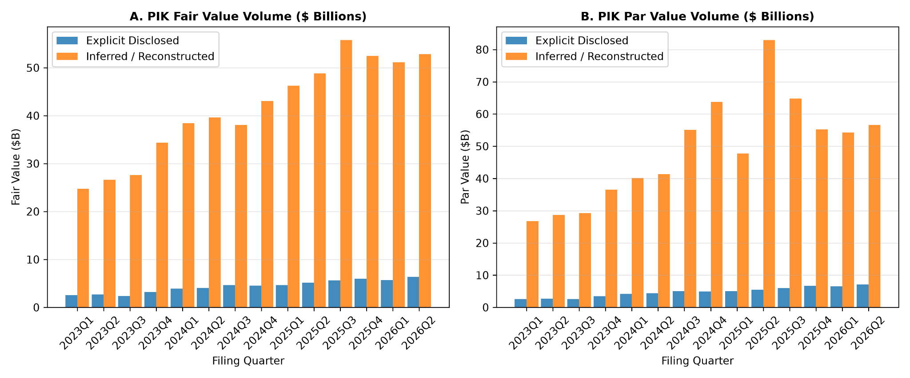
MARATHON ASSET MANAGEMENT
BDC PIK Trends
CORNELL CFEM CAPSTONE 2026
Main Question: Can we use the increasing non-cash portion of the loan as a signal for BDC distress?
What proportion of the PIK data is derived from explicit SEC iXBRL tags and what proportion is imputed?

Slide 10
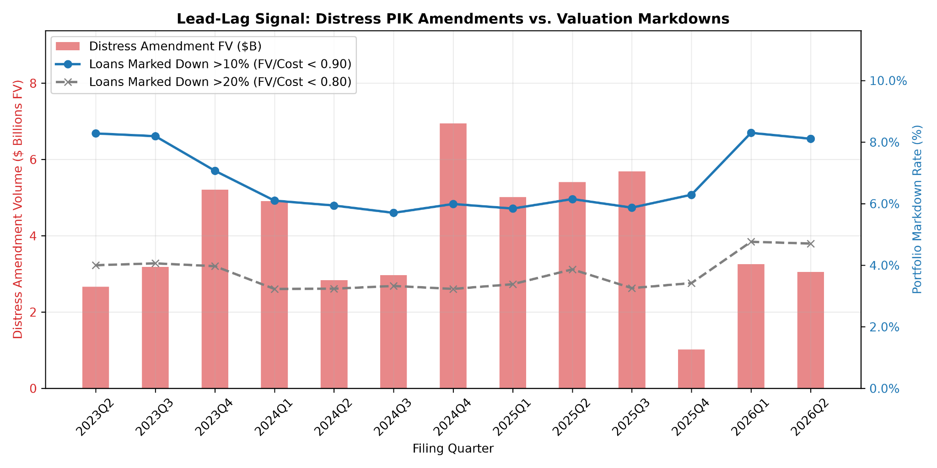
MARATHON ASSET MANAGEMENT
BDC PIK Trends
CORNELL CFEM CAPSTONE 2026
Main Question: Can we use the increasing non-cash portion of the loan as a signal for BDC distress?
What proportion of PIK is from deals structured with PIK at inception versus performing loans converted to PIK during distress amendments?

Slide 11
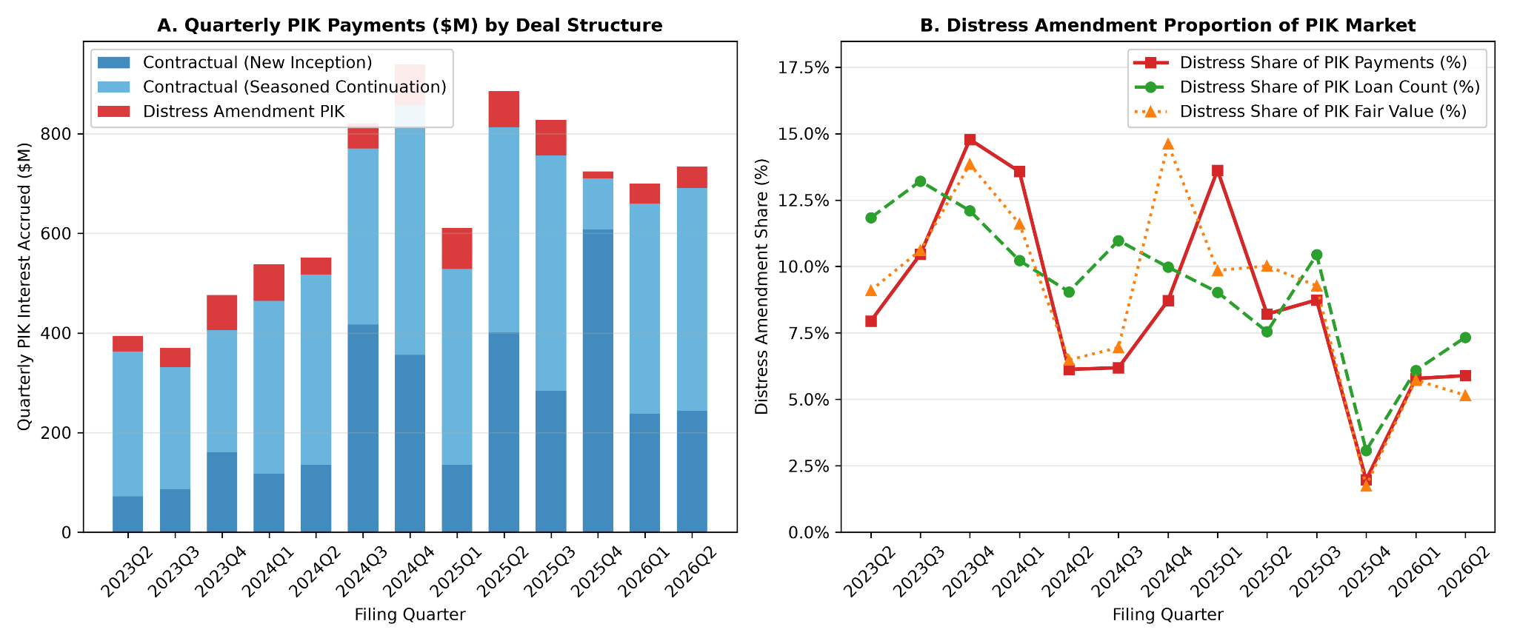
MARATHON ASSET MANAGEMENT
BDC PIK Trends
CORNELL CFEM CAPSTONE 2026
Main Question: Can we use the increasing non-cash portion of the loan as a signal for BDC distress?
What proportion of PIK is from deals structured with PIK at inception versus performing loans converted to PIK during distress amendments?

Slide 12
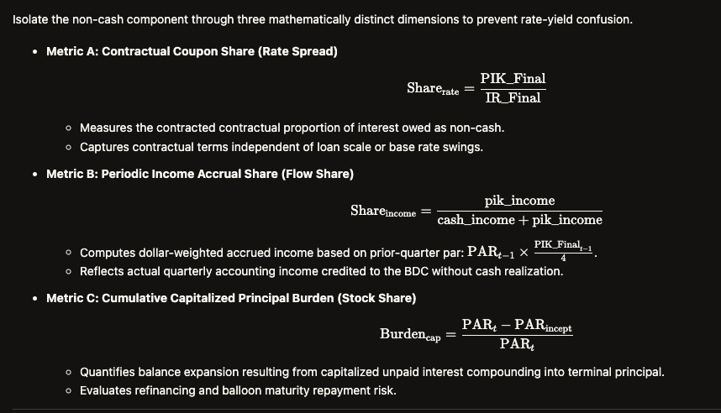
MARATHON ASSET MANAGEMENT
BDC PIK Trends
CORNELL CFEM CAPSTONE 2026
Main Question: Can we use the increasing non-cash portion of the loan as a signal for BDC distress?
Non-Cash Portion Loan Metrics (Three Distinct Channels)

Slide 13
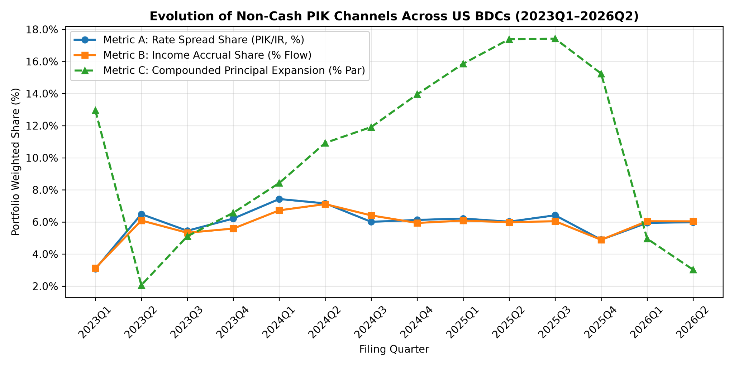
MARATHON ASSET MANAGEMENT
BDC PIK Trends
CORNELL CFEM CAPSTONE 2026
Main Question: Can we use the increasing non-cash portion of the loan as a signal for BDC distress?
Non-Cash Portion Loan Metrics (Three Distinct Channels)

Slide 14
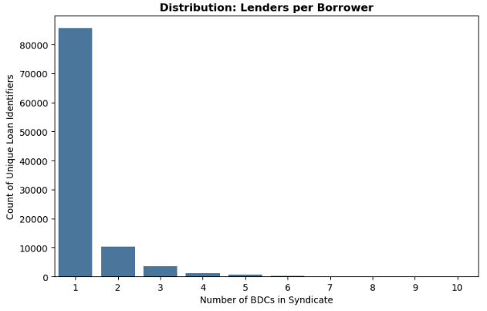
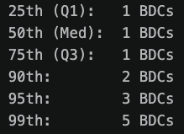
MARATHON ASSET MANAGEMENT
Valuation Dispersion
CORNELL CFEM CAPSTONE 2026

Slide 15
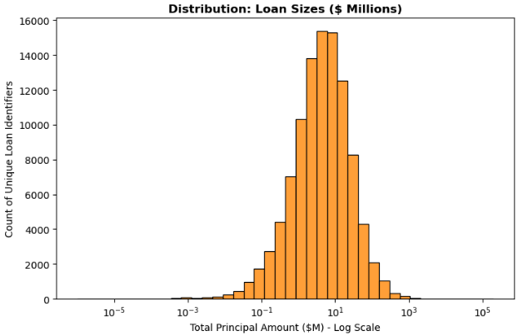
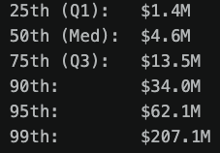
MARATHON ASSET MANAGEMENT
Valuation Dispersion
CORNELL CFEM CAPSTONE 2026

Slide 16
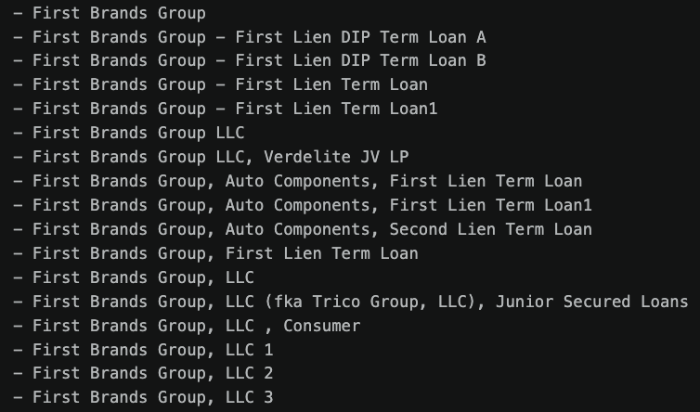
MARATHON ASSET MANAGEMENT
Difficulties
CORNELL CFEM CAPSTONE 2026

Slide 17
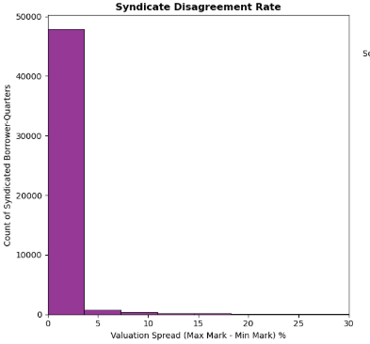
MARATHON ASSET MANAGEMENT
Valuation Dispersion
CORNELL CFEM CAPSTONE 2026
Number on y axis is way less because we are only evaluating borrowers with at least 2 BDCs
Last week's extreme examples are not included in this chart because the spread only goes up to 30%

Slide 18
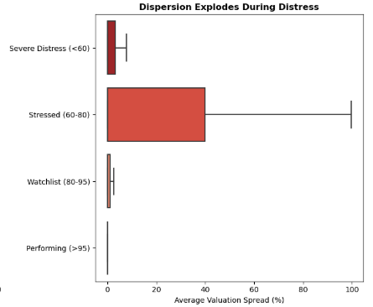
MARATHON ASSET MANAGEMENT
Valuation Dispersion
CORNELL CFEM CAPSTONE 2026
y axis is the average valuation (cents back on a dollar)

Slide 19
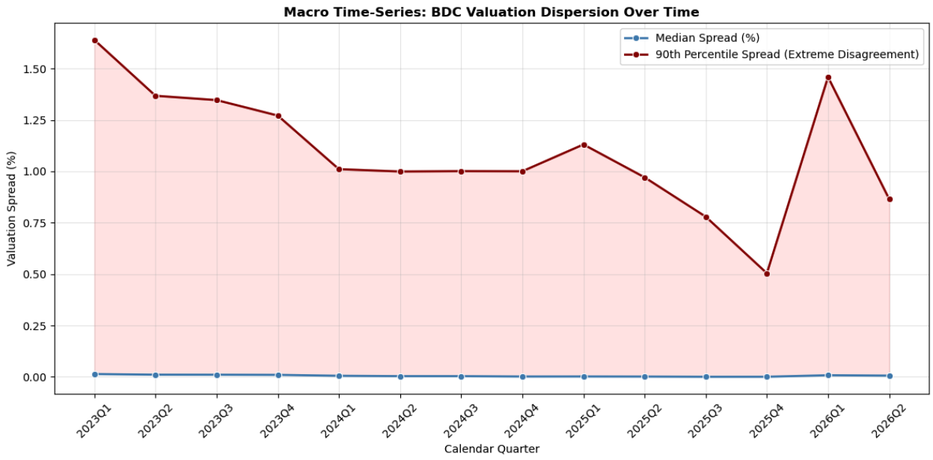

MARATHON ASSET MANAGEMENT
Valuation Dispersion
CORNELL CFEM CAPSTONE 2026

Slide 20
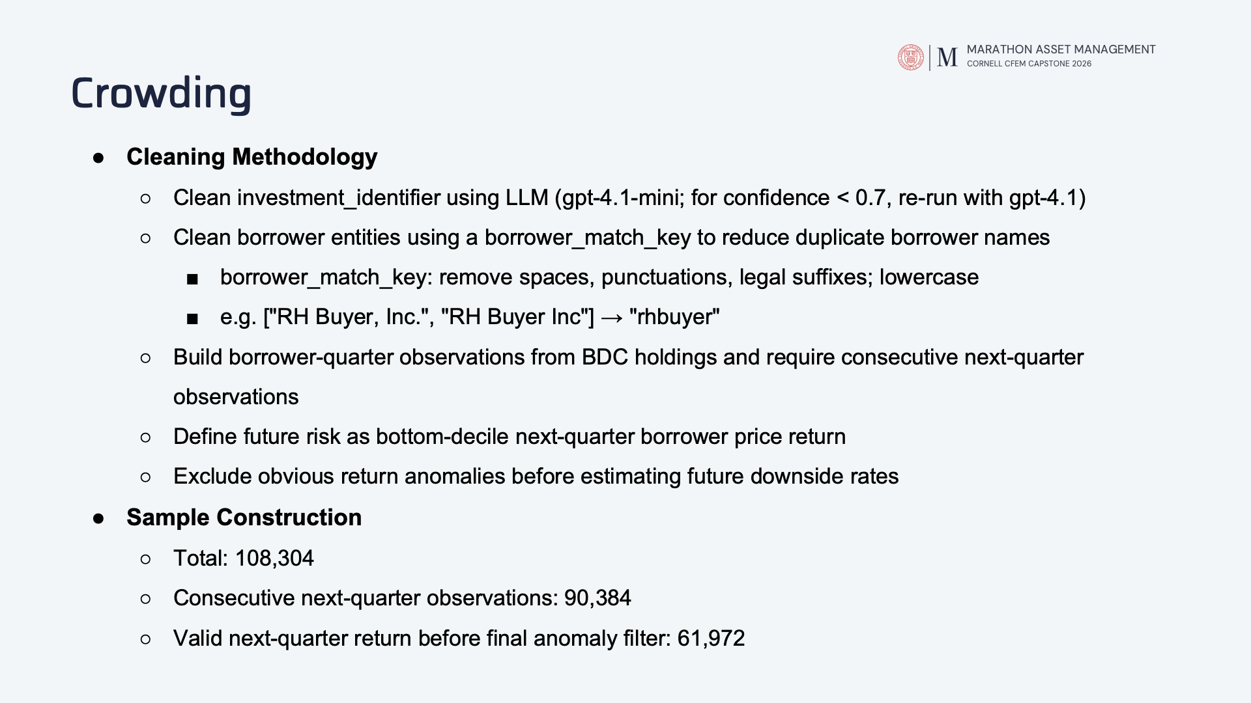

Slide 21
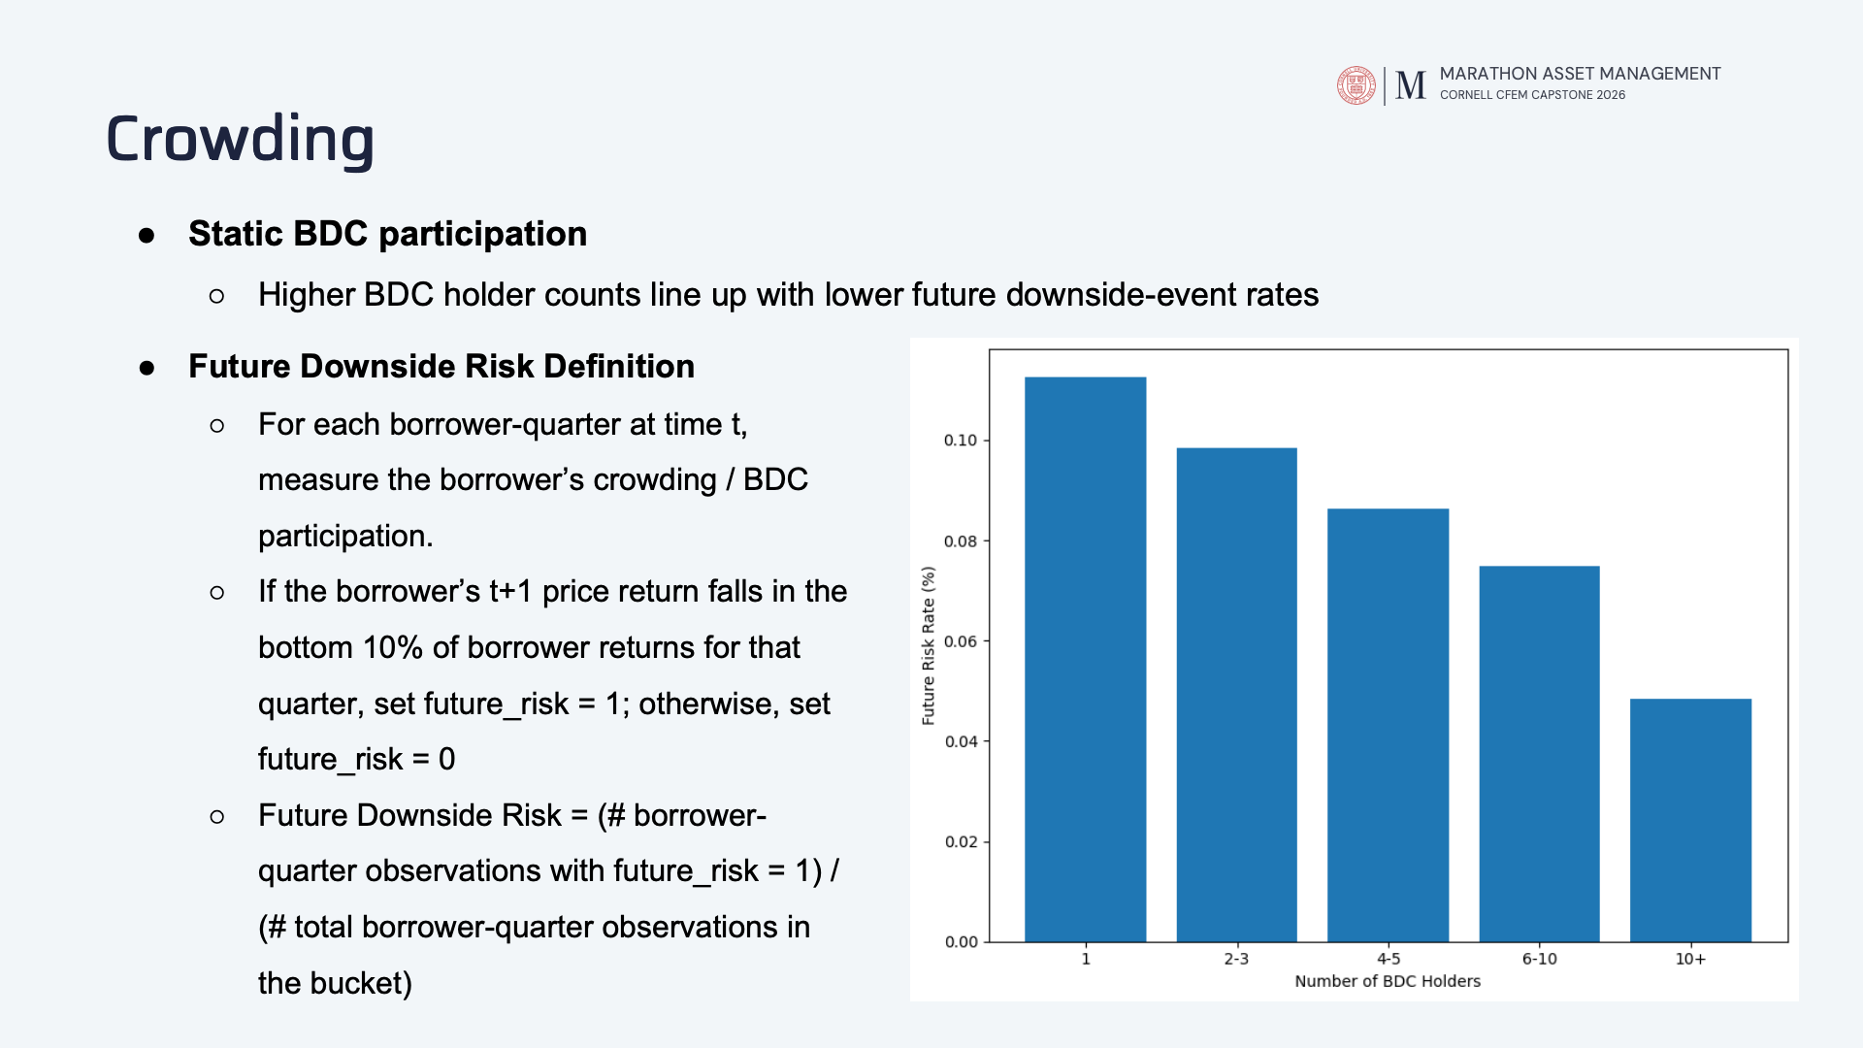

Slide 22
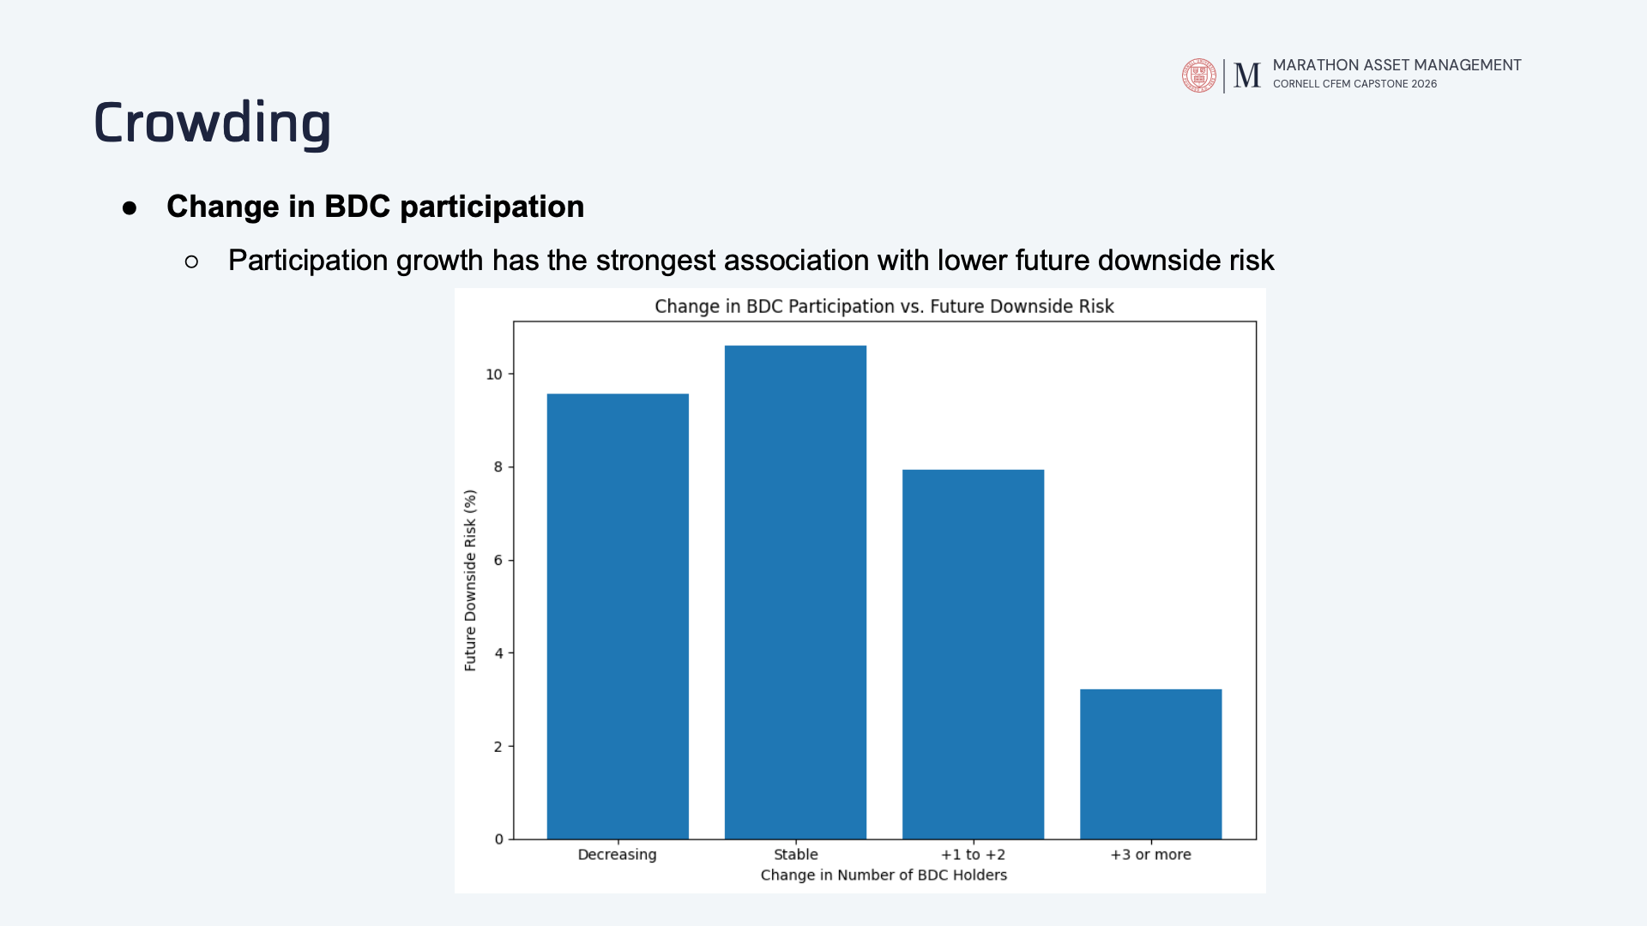

Slide 23
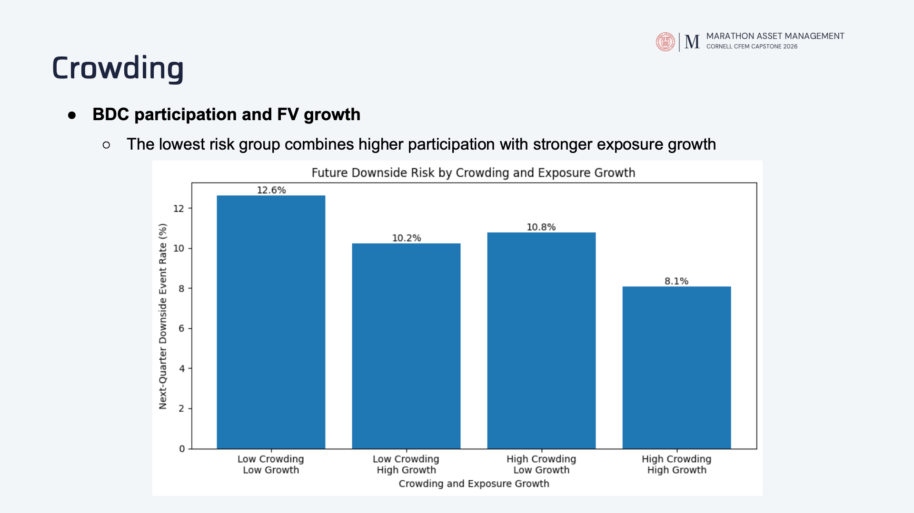

Slide 24
MARATHON ASSET MANAGEMENT
Risk by Sector: Q2 Extraction Results
CORNELL CFEM CAPSTONE 2026
49,333 Q2 2026 records. Rule-based parser built on Alex’s suffix and delimiter idea.
Parser outcome | v1 | v2
Single candidate, identity unverified | 5,028 (10.19%) | 5,092 (10.32%)
Boundary or relationship review | 44,116 (89.42%) | 44,052 (89.30%)
No text candidate | 189 (0.38%) | 189 (0.38%)
Over 64 single-candidate records
1
Notes:
MAIN ENGLISH SCRIPT
For my risk-by-sector work, I first checked the dataset and ran an exploratory screen. I then restarted with name extraction first. Building on Alex’s idea, I used company endings and text separators, kept commas inside names, and flagged unclear cases. This is a rule-based method, without LLM calls. In Q2, version two gives 5,092 single candidates, sixty-four more than version one. Most records still need some boundary or relationship review. These are processing categories, rather than accuracy scores. The useful next question is which unresolved fields actually affect sector analysis.
中文理解与口径提醒
开头用口头交代历史，不再用一整页时间线。早期行业初筛使用原标签；提取优先重启后加回候选名字并做标签诊断。single只表示程序找出一个候选，不表示法律身份已核实。review可包含可用名字，不等于错误；189条无候选也不能直接称无效贷款。v2规则在全期493,182条上运行，表中只展示Q2。
OPTIONAL DETAIL: ONLY IF ASKED
Name Extraction Methodology
Alex suggested using company endings and delimiters. Since there was no reusable code, I implemented one explicit baseline and then added conservative rules. The baseline looks for a familiar company suffix and otherwise uses a comma or pipe boundary. The revised parser preserves the original text, normalizes a copy, and separates clearly marked descriptions. It recognizes more company endings and keeps commas that belong inside a name. It also records ambiguity instead of forcing every record into one company. For example, Goose Borrower, L.P. should keep its comma and full suffix. A former name, such as the Verifone example, stays linked as a relationship that still needs review.
这是规则程序，不是LLM。baseline是我们对Alex文字建议的一种明确实现，不能说是Alex原程序。f/k/a=formerly known as，旧名；d/b/a=doing business as，经营名称。名字提取、法律主体合并、同一笔贷款匹配是三项不同任务。多候选不扩行，金额不复制。完整顺序见本讲稿的方法补充。
Feedback, Rule Changes and Replay
I used the ten development examples to make a limited update. Explicit Term Debt tails explain sixty-two of the new single candidates. A strict repeated-name pattern explains the other two. Twenty Q2 records gained separate current and former-name roles, but they still require review. For C06, I checked the scope before applying a temporary hold. The specific two-name pattern affects three Q2 records and only 0.003728 percent of the numerical sample’s cost. I did not exclude all multi-name records. The full replay preserves every original record and all fifty-eight original columns. Ninety-three development tests and twenty-one integration checks passed, but those checks do not establish real-world extraction accuracy.
C06是Sequential Brands与Galaxy Universal特定共现，20条全期、3条Q2，Q2 Cost 19.462百万美元。只排除此特定模式，不排除所有多候选；后者Q2成本占比约26.07%。MRO只是同一条内的重复文字折叠，不是持仓去重。E1先接回原58列+16列；E2扩至58+26列。测试确认程序行为和数据完整性，没有验证全库法律身份。
Parser Rules and Validation
The baseline is one reproducible interpretation of Alex’s idea, rather than code supplied by Alex. The revised method checks structure before extracting names and treats commas inside company names differently from clear separators. It recognizes compound endings and preserves unexplained material. Candidate positions refer to the normalized text, while the raw text remains available separately. The record link prevents multiple candidates from duplicating an exposure. The existing tests check intended behavior and data integrity. To estimate extraction accuracy, we still need unseen name families and independent source labels, including unresolved cases. Those tests would evaluate names. Debt eligibility and sector labels need their own evaluation.
不要将single、review、abstain当作信用风险分类。全期218,031种原文统一解析后many-to-one接回493,182条。raw_text_id只是文字哈希，不是borrower ID。当前开发登记946种原文，还要排除相关名称族和来源摘录中看到的邻近名字，不能只排除26条就叫独立测试。若测试结果用于修规则，需新留出集。
SOURCES
/Users/olivia/Desktop/FE project_Technology/03_Research_研究/Risk_by_Sector/runs/2026-09-23_2A_input_gate_v1/REPORT_2A_输入检查与待确认.md
/Users/olivia/Desktop/FE project_Technology/03_Research_研究/Risk_by_Sector/runs/2026-09-23_2B_extraction_v1/METHOD_2B_规则与使用边界.md
/Users/olivia/Desktop/FE project_Technology/03_Research_研究/Risk_by_Sector/runs/2026-09-23_2B_extraction_v1/REPORT_2B_候选提取与程序检查.md
/Users/olivia/Desktop/FE project_Technology/03_Research_研究/Risk_by_Sector/runs/2026-09-23_extraction_first_E1_v1/REPORT_E1_先提取再研究.md
/Users/olivia/Desktop/FE project_Technology/03_Research_研究/Risk_by_Sector/runs/2026-09-24_E2_rules_v2/REPORT_E2_C06隔离与规则改进.md
/Users/olivia/Desktop/FE project_Technology/03_Research_研究/Risk_by_Sector/runs/2026-09-23_2D_sector_screen_v1/REPORT_2D_行业初筛与下一步.md
/Users/olivia/Desktop/FE project_Technology/03_Research_研究/Risk_by_Sector/review/2026-09-24_C01_C10_feedback_v1/REPORT_人工反馈评估与证据.md
/Users/olivia/Desktop/FE project_Technology/03_Research_研究/Risk_by_Sector/runs/2026-09-24_2C_source_review_v1/REPORT_2C_来源核查与停止原因.md

Slide 25
MARATHON ASSET MANAGEMENT
Sector Inputs Still Have Coverage Gaps
CORNELL CFEM CAPSTONE 2026
Q2 diagnostic sample: 41,485 records. Percentages use the sample’s Cost as the denominator.
Among 26 targeted source checks
20 excerpt matches
1 name difference
5 partly unresolved
Unknown labels indicate missing classification. The groups overlap and do not measure credit distress.
2
Notes:
MAIN ENGLISH SCRIPT
Two fields remain important. Unknown sector labels cover 21.54 percent of cost, and unknown seniority covers 37.93 percent. These groups overlap, so we should not add them together. I also checked twenty-six priority records against source excerpts. Twenty match the name, cost and fair value. One matches the amounts but has a name difference, and five remain partly unresolved. These were targeted checks, not a random accuracy test. The main result is that extracting a cleaner name does not automatically resolve the loan category or sector used in the analysis.
中文理解与口径提醒
分母由49,333条Q2记录变为41,485条数值诊断样本：正且有限Cost、非负且有限FV，再暂缓C06特定3条记录。Cost合计约522.05十亿美元，是样本报告成本汇总，不能说市场AUM。unknown交集12.58%，不可把两根柱子相加。26条按金额与可疑模式选择；20条只匹配到来源片段，不是完整字段核验，也不是20/26的全库准确率。
OPTIONAL DETAIL: ONLY IF ASKED
Data Scope and the Screening Metric
The frozen dataset contains 493,182 records across fourteen quarters. The parser processes 218,031 distinct descriptions and maps the results back to the records. These are not counts of unique companies. In Q2, there are 49,333 records. The numerical screen keeps mixed-context records with positive finite cost and nonnegative finite fair value. This gives 41,488 records, or 41,485 after a narrowly defined three-record hold. The intended metric is the share of sector cost attached to holdings valued below ninety percent of cost. For example, cost of one hundred and fair value of eighty-five gives a ratio of eighty-five percent. It does not mean a fifteen-percent default probability.
493,182是全期记录，不是公司数；218,031是不同原文，不是borrower数量。Q2数值样本还不是最终已融资贷款库。58条负FV记录不进入这一数值口径，零FV保留。Cost加权：先合计九折以下记录的Cost，再除以该行业所有纳入记录的Cost，不是平均每条FV/Cost。行业未知不能强塞进某个行业。全期持仓金额不能相加当AUM。
Source Review and Label Coverage
I then checked twenty-six priority records against source disclosures. I selected them because of their size or suspected parsing and labeling issues, so this is not a random accuracy sample. Twenty match the name, cost and fair value in the source excerpts. One matches the amounts but has a name difference, and five remain partly unresolved. Separately, the current numerical sample has unknown sector labels covering 21.54 percent of cost and unknown seniority covering 37.93 percent. The overlap is 12.58 percent. These figures describe missing classification coverage, not credit distress. This is why I separated the remaining bottlenecks into five categories.
图表分母是C06暂缓后41,485条记录的Cost 522.053598十亿美元。行业unknown8,088条，seniority unknown13,095条，交集3,975条。占比有重叠不能相加。20/26是片段匹配数量，不能说20条完整验证或76.9%准确率。context可理解为电子披露里给数字定位的上下文；还没逐条完整核对。
SOURCES
/Users/olivia/Desktop/FE project_Technology/03_Research_研究/Risk_by_Sector/runs/2026-09-24_2C_priority_v1/REPORT_2C_核查优先级与标签机制.md
/Users/olivia/Desktop/FE project_Technology/03_Research_研究/Risk_by_Sector/runs/2026-09-24_2C_source_review_v1/REPORT_2C_来源核查与停止原因.md
/Users/olivia/Desktop/FE project_Technology/03_Research_研究/Risk_by_Sector/runs/2026-09-23_2A_input_gate_v1/REPORT_2A_输入检查与待确认.md
/Users/olivia/Desktop/FE project_Technology/03_Research_研究/Risk_by_Sector/runs/2026-09-23_2D_sector_screen_v1/REPORT_2D_行业初筛与下一步.md

Slide 26
MARATHON ASSET MANAGEMENT
Sample Rules Change the Sector Metric
CORNELL CFEM CAPSTONE 2026
Q2 2026. Cost share of holdings with FV / Cost < 0.90. Existing sector labels stay fixed.
Conditional additions: 1,610 One stop records (two Golub CIKs) and 379 hyphen cases.
Same-quarter sample sensitivity only. This does not establish a borrower-name effect or improving credit risk.
3
Notes:
MAIN ENGLISH SCRIPT
This chart shows why those classification gaps matter. The metric is the share of a sector’s cost in holdings valued below ninety percent of cost. Under the existing debt labels, Technology is 7.30 percent and Healthcare is 8.63 percent. We then conditionally add two groups excluded by the current debt-label screen: 1,610 One stop records from two Golub filers, plus 379 hyphen cases. The figures become 6.84 and 8.14 percent, with sector labels unchanged. This is sample sensitivity, not evidence of credit improvement or a borrower-name effect. The proposed additions still need validation.
中文理解与口径提醒
计算方法：九折以下纳入持仓的Cost之和，除以该行业所有纳入持仓的Cost。它不是违约概率、不是平均FV/Cost。本页从原4情景保留首尾2个，降低图表负担：原债权口径与同时加两类。加入的是两个Golub CIK的1,610条One stop以及379条连字符记录，不是全3,518条One stop。金额和行业标签没有改。这不是获批的标签修复，也不是正式行业风险排名。
OPTIONAL DETAIL: ONLY IF ASKED
Conditional Sample Sensitivity
This chart shows why the classification questions matter. I recalculated the below-ninety-percent share under four hypothetical sample definitions. One adds 1,610 One stop records from two Golub filing entities. Another adds the 379 hyphen cases. The fourth adds both. Technology changes from 7.30 percent to 6.84 percent, and Healthcare from 8.63 percent to 8.14 percent when both groups enter. The two sectors keep the same relative order in these four scenarios, but that does not validate every sector ranking. These are changes to the sample within one quarter. The labels have not received final approval, and the exercise does not measure the effect of correcting borrower names.
本页是条件诊断，不是新正式2D结果。四种口径：旧债权标签；加两个Golub CIK One stop；只加连字符；同时加两类。One stop加入1,610条、14.829808十亿美元，只是3,518条总诊断范围的一部分。行业标签不变；未修正金额。独立复算48行sector-scenario汇总一致，证明计算可重复而非标签已正确。
SOURCES
/Users/olivia/Desktop/FE project_Technology/03_Research_研究/Risk_by_Sector/runs/2026-09-24_2C_source_review_v1/REPORT_2C_来源核查与停止原因.md
/Users/olivia/Desktop/FE project_Technology/03_Research_研究/Risk_by_Sector/runs/2026-09-24_2C_source_review_v1/tables/conditional_sample_sensitivity.csv

Slide 27
MARATHON ASSET MANAGEMENT
A–C: Mixed Text and Loan Categories
CORNELL CFEM CAPSTONE 2026
The main problems concern field boundaries and classification rules.
Issue and evidence | Proposed response
A. Name field contains the full description | Separate company, industry and instrument text
B. Unknown rank in 379 hyphen cases and 3,518 One stop records | Recognize debt separately from lien rank
C. “Mezzanine” occurs inside a company name | Classify loan text separately from company words
4
Notes:
MAIN ENGLISH SCRIPT
The first three problems concern how the text is structured. A is that the name field contains the full investment description. I suggest separating the company, industry and loan text while keeping the original. B is that existing rules miss the tested first-lien spelling and the One stop category. We should identify whether an instrument is debt separately from its exact repayment priority. C is that a company name can contain a word like Mezzanine and trigger a loan rule. These fixes would use separate fields, with source checks before any new labels enter the main sample.
中文理解与口径提醒
A已发现上游复制完整描述，不能归咎原始filing一定错误。B的379条Cost约13.363bn；3,518条One stop来自7个CIK、Cost约18.992bn，两类规模不是风险损失。One stop描述融资结构，first lien描述担保顺位，可同时成立。C的Diamond Mezzanine是公司名字干扰工具词的例子；BCTO则可能同时存在first-lien holdco和经济上mezzanine的维度，不能简单规定一个关键词覆盖另一个。方案尚未实施。
OPTIONAL DETAIL: ONLY IF ASKED
A. Mixed Information in the Name Field
Problem A is the structure of the input. The borrower-name column originally copied the entire investment description. It may contain a company, industry, instrument, former name and footnotes together. That is a limitation of the data representation. It does not prove the filing is wrong. My preliminary solution is to retain the original text and extract separate fields only where the boundaries are supported. The output would distinguish the company candidate from industry and instrument information. I would test the rules on unseen name families and check that each output still links to exactly one source record. Legal-entity matching would remain a separate task.
A不是要求删掉公司名之外所有文字。那些文字可能正好是行业和工具证据，应分列保留。可从明确模板试点，不是立刻全库重建。验收包括未见名称族边界正确性、无法判断比例和一对一回接。待团队确认：当前行业研究保留holding-level单位，borrower合并另做。
B. Recognizable Loans Fall into Unknown
Problem B is a coverage gap in the instrument rules. The tested First-lien spelling includes a hyphen that the first-lien branch misses. That affects 379 records. Another 3,518 records contain a separate One stop description, but their current seniority label is unknown. Their reported cost is about nineteen billion dollars within our sample. One stop refers to a combined financing structure, often called unitranche. It does not automatically identify the exact lien rank of every record. I suggest separating debt eligibility from lien ranking, normalizing instrument wording, and adding One stop as a category. The test would check the affected patterns and the resulting sample changes before approving new labels.
First lien问担保顺位，One stop问融资结构，两个维度可同时成立。表中金额不是已验证市场AUM，也不是风险损失。7个CIK不等于7个独立管理人。379条已做文字机制回放，但不是逐笔法律认证；3,518条是全7CIK覆盖诊断，后面的敏感性只加入其中两个CIK的1,610条。待团队决定债权主样本定义。
C. Name Words and Loan Labels Interact
Problem C has two parts. In Diamond Mezzanine, the word Mezzanine is inside the company name, but the classifier searches the whole description. That can override the actual loan wording. BCTO is different. Its disclosure says first-lien holdco loan, while a mezzanine category summary matches its amounts. This suggests that collateral priority and economic position may describe different aspects of the same investment. That interpretation still needs source-context confirmation. I suggest separating the instrument text, lien rank, holding-company structure and issuer category. One simple test is to change only a company name in a test record. If the loan description stays the same, its classification should not change.
Mezzanine一般指夹层/较次级融资，但公司名里有这个词不等于这笔贷款是夹层。Holdco是控股公司：对母公司某些抵押品有first lien，不自动等于对子公司全部资产也排最前。P20金额一致只是支持解释的线索，不是已核实法律结论。P24 Cost/FV 132.628/133.152百万；P20 228.106/230.594百万。方案避免一律让First lien覆盖Mezzanine。
Loan Terms Used in This Update
First lien describes priority over specified collateral. In a simplified example, a first-lien lender owed sixty and a second-lien lender owed forty share collateral worth seventy. Ignoring other claims and costs, the first lender receives sixty and the second receives ten. One stop describes a financing structure that combines senior and junior features. It can also have a first-priority lien, so the two labels can coexist. Mezzanine generally refers to a more junior financing position, but a word in a company’s name tells us nothing by itself. A holdco is a holding company, so we also need to understand which entity borrowed and what assets support the claim.
简化例子只帮助理解，真实回收有费用、其他优先权和担保范围等限制。First lien不是保证偿付。One stop也不表示只有一家放贷机构。Holdco借款人的担保权不能未经核实就扩展到全部子公司资产。FV是估值，Cost是账面投资成本；本项目当前主要观察估值折价，不是直接估计违约概率或投资总收益。
SOURCES
/Users/olivia/Desktop/FE project_Technology/03_Research_研究/Risk_by_Sector/runs/2026-09-23_2A_input_gate_v1/REPORT_2A_输入检查与待确认.md
/Users/olivia/Desktop/FE project_Technology/03_Research_研究/Risk_by_Sector/runs/2026-09-24_2C_priority_v1/evidence/label_method_audit.md
/Users/olivia/Desktop/FE project_Technology/03_Research_研究/Risk_by_Sector/runs/2026-09-24_2C_priority_v1/REPORT_2C_核查优先级与标签机制.md
/Users/olivia/Desktop/FE project_Technology/03_Research_研究/Risk_by_Sector/runs/2026-09-24_2C_source_review_v1/REPORT_2C_来源核查与停止原因.md
https://golubcapitalbdc.com/investor-resources/frequently-asked-questions/
https://www.sec.gov/Archives/edgar/data/1901606/000190160624000070/gdlcu-20240930.htm
/Users/olivia/Desktop/FE project_Technology/03_Research_研究/Risk_by_Sector/runs/2026-09-23_2B_extraction_v1/METHOD_2B_规则与使用边界.md
https://www.sec.gov/Archives/edgar/data/1812554/000181255426000047/orcic-20260630.htm
https://www.sec.gov/Archives/edgar/data/1925309/000119312526335004/ck0001925309-20260630.htm
https://www.sec.gov/Archives/edgar/data/1383414/000119312519254763/d805780d497.htm

Slide 28
MARATHON ASSET MANAGEMENT
D–E: Sector Mapping and Field Evidence
CORNELL CFEM CAPSTONE 2026
Some differences need an agreed definition. Others need a source check.
Observed problem | Possible explanation | Proposed response
D. Professional Services versus Technology | Different sector definitions Limited mapping history | Agree a sector crosswalk Retain source and method
E. Text and spread differ in 14 of 606 records* | Stale text or field linkage Cause remains unconfirmed | Check the specific field Keep an exception log
One Call: numerical spread 0.0575 agrees with the source’s S+575.
5
Notes:
MAIN ENGLISH SCRIPT
The other two problems need a different approach. For D, a source industry such as Professional Services may map differently to our Technology category. That difference alone does not establish an error. We need a shared mapping and a record of the evidence. For E, fourteen of 606 comparable records in one Apollo template have different spreads in the text and numerical field. In the One Call example, the numerical field actually agrees with the source. I suggest checking each affected field and recording exceptions, rather than replacing numbers from the description or dropping the whole holding.
中文理解与口径提醒
crosswalk就是“来源行业名称→项目行业分类”的映射表。当前最终输出未保留完整规则/模型/置信度/来源字段，追溯有限。E的原因尚未确立：描述S+475、数值0.0575、来源S+575，说明数值可能正确，不能倒过来用描述覆盖。S+475是SOFR加4.75个百分点，非总利率4.75%。606是该模板可比较记录；另2条缺数值不在分母里。利差有争议不自动让Cost/FV不可用。
OPTIONAL DETAIL: ONLY IF ASKED
D. Sector Mapping Needs a Clear Record
Problem D concerns the sector labels themselves. The current method uses ordered keyword rules and an LLM fallback, but the final export drops the intermediate source and confidence fields. That makes a row difficult to trace. Guidehouse and Denali also illustrate a possible mapping difference: Professional Services in source headings and Technology in our data. That difference is not automatically an error. My proposal is to preserve the source industry and apply a shared mapping to the project sectors, with evidence and method recorded. We would independently check the mapping and test alternative reasonable choices for disputed cases. Unknown exposure would remain visible instead of disappearing from the denominator discussion.
crosswalk就是“来源行业名称到项目大行业”的映射表。未取得完整连续表头上下文的例子仍待核；不能直接把Technology判错。最终表删除sector_rule/sector_llm/sector_llm_conf/sector_source等追溯字段，现无法还原每行当时依据。模型confidence不是经校准准确率。31.97%的分母只在单一候选记录内部，与21.54%不同。团队应决定分类口径，助手不能替团队编造唯一正确行业。
E. Text and Numerical Fields Disagree
Problem E is a disagreement between text and numbers. In One Call, the long description says SOFR plus 475 basis points. The separate spread field is 5.75 percent, which agrees with the matched filing excerpt. So I should not overwrite that number using the description. Within one explicit Apollo template, fourteen of 606 comparable Q2 records show a text-versus-number difference. This is not a count of fourteen numerical errors. The cause could involve stale text or field correspondence, but we have not established it. I suggest a field-specific exception log and targeted source checks. A spread issue should affect spread research. By itself, it does not show that the matched cost or fair value is unusable.
S表示SOFR，475 bps=4.75个百分点，这里比较的是spread而非总贷款利率。14/606是单一明确模板内不一致筛查，不是全库错误率。P12 Aurelia是另一类：Cost/FV对得上但MidCo2名称和本金文字有差异，仍需对照；不能自动合并名字。方案不从描述反向覆盖正确数值，也不因一个字段疑点丢掉整个样本。
SOURCES
/Users/olivia/Desktop/FE project_Technology/03_Research_研究/Risk_by_Sector/runs/2026-09-24_2C_priority_v1/evidence/label_method_audit.md
/Users/olivia/Desktop/FE project_Technology/03_Research_研究/Risk_by_Sector/runs/2026-09-24_2C_source_review_v1/REPORT_2C_来源核查与停止原因.md
https://www.sec.gov/Archives/edgar/data/1837532/000119312526341358/ck0001837532-20260630.htm
https://www.sec.gov/Archives/edgar/data/1803498/000180349826000048/bcred-20260630.htm
https://www.sec.gov/Archives/edgar/data/1930087/000193008726000099/gcred-20260630.htm
/Users/olivia/Desktop/FE project_Technology/03_Research_研究/Risk_by_Sector/runs/2026-09-24_2C_priority_v1/REPORT_2C_核查优先级与标签机制.md
https://www.sec.gov/Archives/edgar/data/1925309/000119312526335004/ck0001925309-20260630.htm

Slide 29
MARATHON ASSET MANAGEMENT
Next Step 1: A Focused Source Pilot
CORNELL CFEM CAPSTONE 2026
Proposed starting scope: the tested hyphen pattern and two Golub filing entities.
Action | Concrete output
Match the exact filing, period and holding | Record-to-source evidence table
Separate names, industry and instrument text | Structured fields with unresolved flags
Apply agreed debt and sector definitions | Versioned labels with reasons for each change
One pilot output, then review before expanding
6
Notes:
MAIN ENGLISH SCRIPT
My proposed next step is a focused source pilot. I would begin with the tested hyphen pattern and the two Golub filing entities used in the sensitivity check. First, match the filing, period and holding. Then separate the company, industry and instrument evidence. Finally, apply debt and sector definitions agreed with the team. The output would be one versioned table showing the original value, proposed value and supporting source. Automation can prepare the table. I would bring only unresolved definitions and evidence conflicts to the team, and review the pilot before expanding it.
中文理解与口径提醒
这是建议的下一小任务，不代表现在又开始跑全库。顺序是：先确认来源对应，再拆字段，最后映射；找不到明确证据就保留unknown或只隔离受影响字段。优先组用来开发/试点，不能转头当独立测试。助手可负责整理来源、执行确定规则、生成前后对照；Olivia不用逐条查数万条，团队集中处理分类定义和证据冲突。试点范围并非自动批准把所有1,610或379条正式纳入。
OPTIONAL DETAIL: ONLY IF ASKED
This slide presents a proposed next step. No new research action has been executed.
SOURCES
/Users/olivia/Desktop/FE project_Technology/03_Research_研究/Risk_by_Sector/runs/2026-09-24_2C_priority_v1/REPORT_2C_核查优先级与标签机制.md
/Users/olivia/Desktop/FE project_Technology/03_Research_研究/Risk_by_Sector/runs/2026-09-24_2C_source_review_v1/REPORT_2C_来源核查与停止原因.md
/Users/olivia/Desktop/FE project_Technology/03_Research_研究/Risk_by_Sector/runs/2026-09-24_2C_priority_v1/evidence/label_method_audit.md

Slide 30
MARATHON ASSET MANAGEMENT
Next Step 2: Independent Validation
CORNELL CFEM CAPSTONE 2026
Proposed checks before the pilot becomes an approved research input.
Check | Required evidence
Names and labels | Unseen families and source-template coverage
Coverage | Record and Cost coverage, including unresolved cases
Research impact | Same metrics under plausible sample and sector choices
A lower unknown share alone is insufficient
7
Notes:
MAIN ENGLISH SCRIPT
The second step is to test whether the pilot actually improves the data. I would freeze the rules, then use unseen name families that exclude our development cases and related examples. Names, debt categories and sector labels would each need source review. I would report both record coverage and cost coverage, including unresolved cases. I would also repeat the same sector metric under reasonable alternative definitions. Before testing, we should agree on acceptance criteria and who reviews disagreements. If material errors remain, we revise the relevant rule and use a fresh test set before claiming success.
中文理解与口径提醒
独立测试不是把26条重新检查一次；已见过的名称族和开发例子都排除。按来源模板、候选状态、金额区间分层，避免只选高Cost或容易的名字。助手生成样本与证据包；需明确独立审核人确认参考答案，不能把模型自信分当真值。建议比较旧/新方法在同一留出样本上的边界正确率与标签一致性，并报告分组、数量和不确定性。准确率门槛/可容忍影响由团队预先约定，此处没有虚构达标数字。所有原记录与金额不变也要程序核查；若看过测试后改规则，原测试退为开发，需新留出集。
OPTIONAL DETAIL: ONLY IF ASKED
This slide presents a proposed next step. No new research action has been executed.
SOURCES
/Users/olivia/Desktop/FE project_Technology/03_Research_研究/Risk_by_Sector/runs/2026-09-23_2B_extraction_v1/METHOD_2B_规则与使用边界.md
/Users/olivia/Desktop/FE project_Technology/03_Research_研究/Risk_by_Sector/runs/2026-09-24_E2_rules_v2/REPORT_E2_C06隔离与规则改进.md
/Users/olivia/Desktop/FE project_Technology/03_Research_研究/Risk_by_Sector/runs/2026-09-24_2C_source_review_v1/REPORT_2C_来源核查与停止原因.md

Slide 31
MARATHON ASSET MANAGEMENT
Next Step 3: Sector Research Outputs
CORNELL CFEM CAPSTONE 2026
After validation: a documented holding-level sample and a defensible sector comparison.
Planned deliverable | Question it answers
Sector scorecard with coverage | Where are valuation discounts concentrated?
Sample and filer sensitivity checks | Does the pattern survive reasonable choices?
One source-backed case study | What explains a selected holding’s valuation pattern?
sample definition and sector crosswalk
8
Notes:
MAIN ENGLISH SCRIPT
After those checks, I would move to the sector output. The first deliverable would compare valuation discounts across sectors and show the remaining coverage gaps. Then I would test whether the pattern survives changes in sample definition and which filers are included. That would guide the choice of one case study, using source evidence to explain the valuation pattern. The immediate decision I need from the team is the main debt sample and sector mapping. We can define a holding-level study without first merging every borrower, while still requiring stronger identity checks for the selected case.
中文理解与口径提醒
这是工作目的，避免一直循环清洗却没有研究出口。holding-level按一条持仓观察，不自动把同名公司合并；行业研究先需要这条持仓的行业/工具/金额可靠。不同季度变化可先做相同申报机构范围的对照，但不等于同一批贷款变差；case若需要跨季度/跨BDC比较，应额外核对借款主体和贷款合同。新增PIK或利差风险信号之前也须对应字段核验。当前仍为2C，正式2D和Stage3案例尚未发布。
OPTIONAL DETAIL: ONLY IF ASKED
Current Deliverables and Team Decisions
The outputs so far are a reproducible candidate-name pipeline, a record of limited rule changes, source-review evidence, and quantified sample issues. The independent accuracy assessment and validated sector conclusions are still pending. I would like feedback on three decisions. First, can the sector work proceed at the individual-holding level while entity matching remains a separate workstream? Second, which debt categories and sector definitions should form the main sample? Third, what source evidence and sensitivity tests should we require before making a claim, and who should review disputed mappings? Each proposed fix should show what changed, whether independent evidence supports it, and whether it affects the research interpretation.
可以明确向导师说：本周贡献是定位可复现的数据处理瓶颈和其样本影响，不是已经发现可预测违约的risk factor。A-E都是初步方案，尚未执行或验证。不要承诺清完几十万条后才能分析，也不以压低unknown比例作唯一KPI。当前正式2D仍待验收，Stage3新公司case尚未确立。
Historical Sector Screen
This backup shows the earlier exploratory screen. It used the original fields before the extraction-first restart. I calculated cost-weighted shares below ninety and eighty percent of cost, compared eleven sample definitions, checked a fixed set of filers across five quarters, and removed the largest filer as a sensitivity check. The table shows a reversal in the Technology–Healthcare order when the sample changes. That motivated further scrutiny of coverage and instrument labels. It does not prove borrower-name errors caused the reversal. A fixed-filer sample also does not track a fixed set of borrowers or loans. I am keeping these numbers as a historical diagnostic baseline.
导师问早期分析做了什么时再展开。11种口径包括币种、缩放日志、债权标签、宽文本资产旗标、组合启发式、第一留置权、日历季末、行业冲突键、重复原文组、FV/Cost异常等。固定最近5季均出现的145个CIK，并非固定贷款。按原文重复组排除只是敏感性，不是认为都重复。未建立实时可得性回测，不能声称early warning。
SOURCES
/Users/olivia/Desktop/FE project_Technology/03_Research_研究/Risk_by_Sector/runs/2026-09-24_2C_source_review_v1/REPORT_2C_来源核查与停止原因.md
/Users/olivia/Desktop/FE project_Technology/03_Research_研究/Risk_by_Sector/runs/2026-09-23_2D_sector_screen_v1/REPORT_2D_行业初筛与下一步.md
/Users/olivia/Desktop/FE project_Technology/03_Research_研究/Risk_by_Sector/runs/2026-09-24_E2_rules_v2/REPORT_E2_C06隔离与规则改进.md
/Users/olivia/Desktop/FE project_Technology/03_Research_研究/Risk_by_Sector/runs/2026-09-24_2C_priority_v1/evidence/label_method_audit.md

